Slide 1


Active inference and artificial curiosity
Karl Friston
Abstract: In the cognitive neurosciences and machine learning, we have formal ways of characterising perception and decision-making: current formulations of perceptual synthesis call on theories like predictive coding and the Bayesian brain hypothesis. Conversely, formulations of decision-making and choice behaviour appeal to reinforcement learning and the Bellman optimality principle. On the one hand, the brain seems to be in the game of optimising beliefs about how its sensations are caused; while, on the other hand, our choices and decisions appear to be governed by value functions and reward. Are these formulations irreconcilable, or is there some underlying imperative that renders perceptual inference and decision-making two sides of the same coin.
This talk offers a formal account of insight and learning in terms of active (Bayesian) inference. It deals with the dual problem of inferring states of the world and learning its statistical structure. In contrast to current trends in machine learning (e.g., deep learning), we focus on how agents learn from a small number of ambiguous outcomes to form insight. I will simulations of abstract rule-learning and approximate Bayesian inference to show that minimising (expected) free energy leads to active sampling of novel contingencies. This epistemic, curiosity-directed behaviour closes `explanatory gaps' in knowledge about the causal structure of the world; thereby reducing ignorance, in addition to resolving uncertainty about states of the known world. We then move from inference to model selection or structure learning to show how abductive processes emerge when agents test plausible hypotheses about symmetries in their generative models of the world. The ensuing Bayesian model reduction evokes mechanisms associated with sleep and has all the hallmarks of aha moments.
Key words: active inference ∙ insight ∙ novelty ∙ curiosity ∙ model reduction ∙ free energy ∙ epistemic value ∙ structure learning

Slide 2
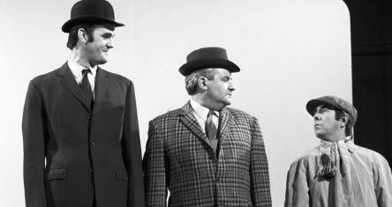
The free energy principle in 3 slides
Karl Friston, University College London
Neats Scruffies Mystics
physics machine learning philosophy

Slide 3

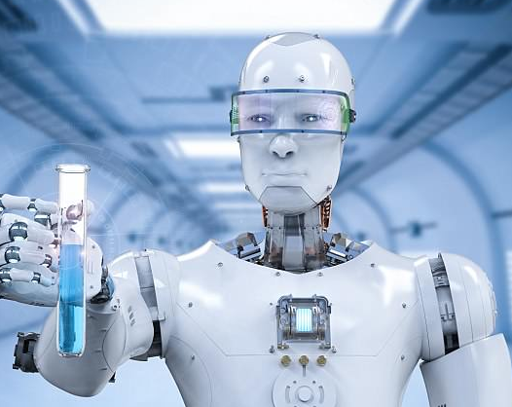

Neat and simple
bound
evidence
evidence
Explainable AI
Explicit generative models
Transparent prior assumptions
Hyperparameter optimization
Design optimality
Optimal Bayesian design
Abductive inference
Autopoietic and autodidactic
Data foraging and epistemics – AGI
Active inference with sparse data

Slide 4
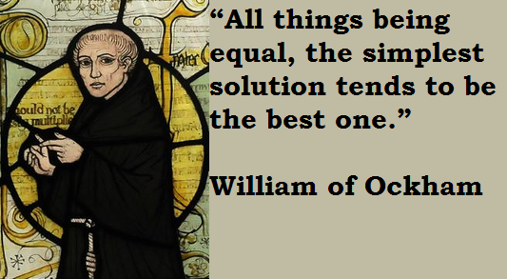


Neat and simple
complexity
accuracy
evidence
Occam’s principle
Functional specialisation
Redundancy minimisation
Efficient coding
Computational cost
Bounded rationality
Approximate Bayesian inference
Heuristics (priors)
Jarzynski equality and Landauer’s principle
Thermodynamic efficiency

Slide 5
A game (abstract rule)
Your prior beliefs:
You will choose the correct colour based on the arrangement of the three large circles.
The location of the correct colour depends upon the colour of the upper circle.

Slide 6
A game (abstract rule)
Your prior beliefs:
You will choose the correct colour based on the arrangement of the three large circles.
The location of the correct colour depends upon the colour of the upper circle.

Slide 7
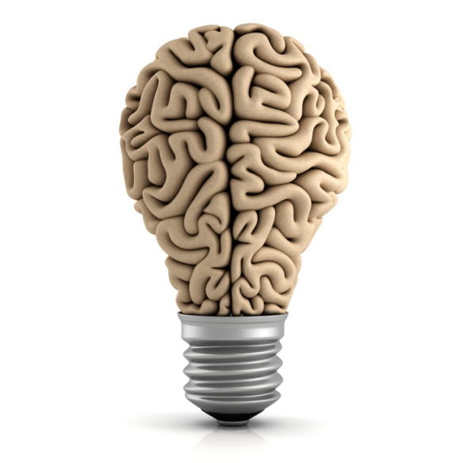
Active inference and self-evidencing
Generative models and active inference
Novelty and epistemic affordance
Sleep and structure learning
Inferring states of the world
Learning model parameters
Learning model structure

Slide 8
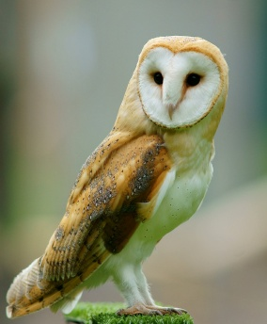

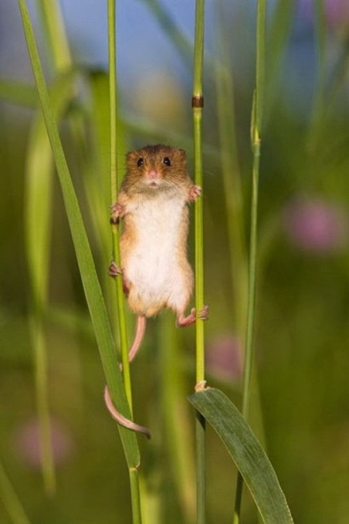
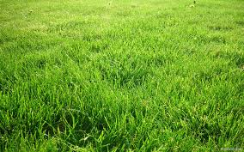
Imagine you are an owl – and you are hungry…

Slide 9
Optimal action depends on states of the world
Optimal action depends on beliefs about states
and subsequent action
Bellman’s Optimality Principle:
Optimal control theory
Dynamic programming
Deep reinforcement learning and expected utility
Bayesian decision theory
State-action policy iteration
MDP
….
Hamilton's Principle of least Action:
Free energy principle
Active inference
Artificial curiosity and intrinsic motivation
Optimal Bayesian design
Sequential policy optimisation
POMDP
….

Slide 10
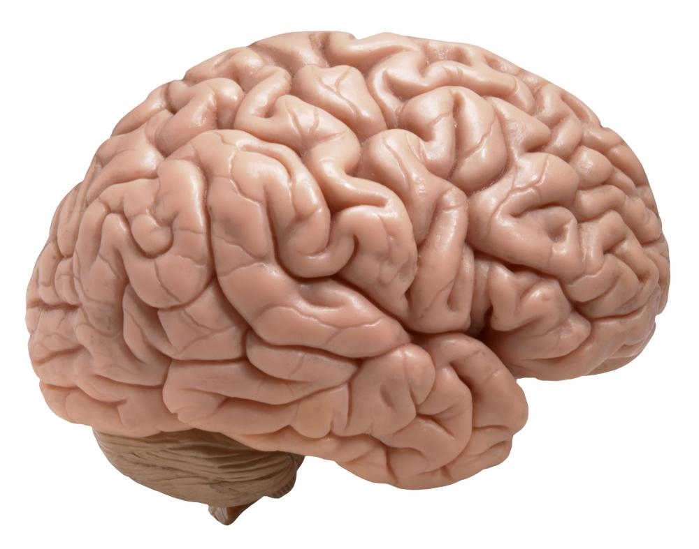
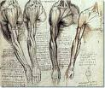

Active inference
Expected free energy maximisation
Policy selection
Risk
Ambiguity
External states
Markov blanket
Free energy maximisation
Perceptual inference
Complexity
Accuracy

Slide 11
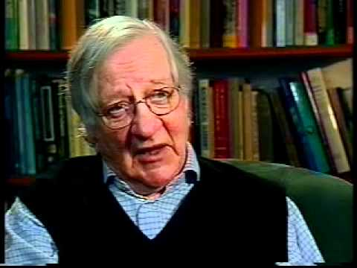
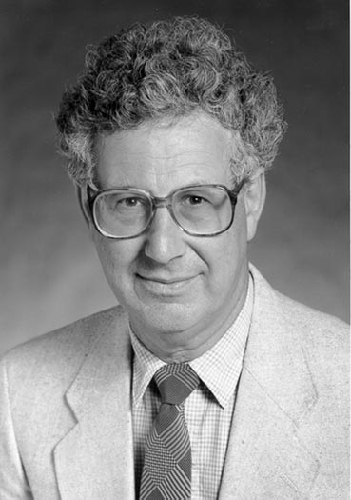
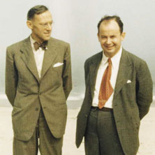
Active inference
Complexity
Accuracy
Perceptual inference
Evidence bound
Log evidence
Risk
Ambiguity
Policy selection
Intrinsic value
Extrinsic value
Bayesian surprise and Infomax
No prior beliefs or preferences:
KL or risk-sensitive control
No ambiguity (i.e., known states):
Expected utility theory
No uncertainty or risk:
Bayesian surprise
Mutual information
Divergence from prior preferences
Expected value

Slide 12


+
=
Bayes optimal decisions
Bayes optimal design
Active inference
+
=
Expected value
Information gain
Expected free energy

Slide 13
Predictive processing and free energy
Generative models and active inference
Novelty and epistemic affordance
Sleep and structure learning

Slide 14

A generative model
Likelihood
Empirical priors – hidden states
Precision
– control states
Policy
Full priors
Hidden states
Approximate posterior

Slide 15
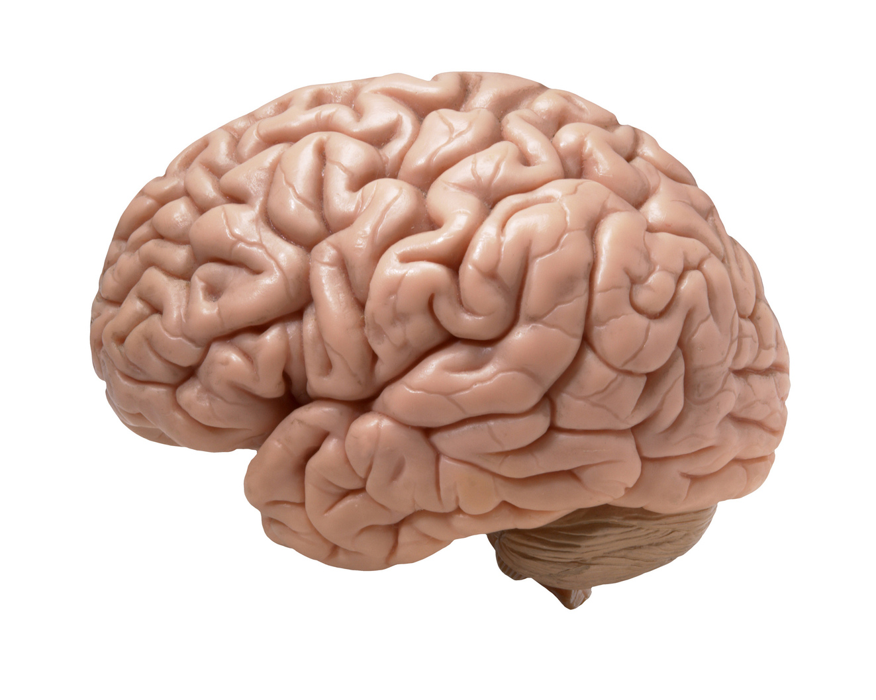
Functional anatomy and message passing
Belief updating
Perception
Policy selection
Precision
motor cortex
Learning
occipital cortex
prefrontal cortex
striatum
hippocampus
Action selection
VTA/SN

Slide 16


Two-step maze task
Control states
Generative model
1 2 3 4
location
Hidden states
CS
location
context
Outcomes

Slide 17
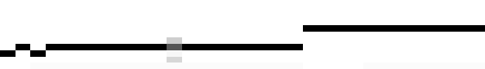

From exploration to exploitation
(epistemic foraging)
Initial state and policy selection
2
US
Policy
4
US
6
8
10
5
10
15
20
25
30
Final outcome, performance and reaction times
4
2
Expected utility
CS
0
CS
-2
5
10
15
20
25
30
Learning (D)
2
4
Hidden state
6
8
5
10
15
20
25
30
Trial

Slide 18
Active inference and self-evidencing
Generative models and active inference
Novelty and epistemic affordance
Sleep and structure learning

Slide 19


A game (abstract rule)
Your prior beliefs:
You will choose the correct colour based on the arrangement of the three large circles.
The location of the correct colour depends upon the colour of the upper circle.
…..
Choosing where to look next

Slide 20





Hidden states
rule
colour
where
centre
left
start
right
left center right
Priors
choice
r
g
b
r
g
b
r
what
g
b
r
g
b
r
g
b
r
g
b
Correct color
Correct color
where
centre
left
start
right
feedback
Outcomes

Slide 21
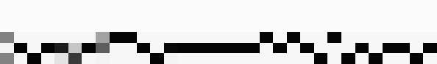
Rule learning
Initial state and policy selection
Policy
2
4
6
5
10
15
20
25
30
Final outcome and performance
5
Expected utility
0
-5
5
10
15
20
25
30
Free energy
34
nats
32
30
28
26
5
10
15
20
25
30
Confidence
nats
-6.5
-7
-7.5
5
10
15
trial
20
25
30

Slide 22
But why look anywhere, if the consequences of action had no meaning – and could resolve no uncertainty?
Active inference
Expected free energy maximisation
Policy selection
Risk
Ambiguity
Novelty
External states
Markov blanket
Free energy maximisation
Perceptual inference
Complexity
Accuracy
Parametric learning
Complexity
Accuracy

Slide 23
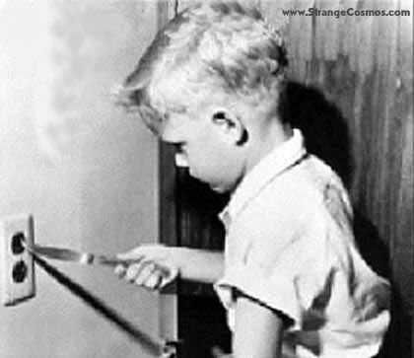
But why look anywhere, if the consequences of action had no meaning – and could resolve no uncertainty?
Expected free energy and novelty
novelty
salience
utility
Novelty: “what happens if I do that?”

Slide 24
Active inference and self-evidencing
Generative models and active inference
Novelty and epistemic affordance
Sleep and structure learning

Slide 25
Bayes optimal rule learning?
Initial state and policy selection
Policy
2
4
6
5
10
15
20
25
30
Final outcome and performance
5
Expected utility
0
-5
5
10
15
20
25
30
Free energy
34
nats
32
30
28
26
5
10
15
20
25
30
Confidence
nats
-6.5
-7
-7.5
5
10
15
trial
20
25
30

Slide 26
Active inference
Expected free energy maximisation
Policy selection
Risk
Ambiguity
Novelty
External states
Markov blanket
Free energy maximisation
Perceptual inference
Complexity
Accuracy
Parametric learning
Complexity
Accuracy

Slide 27
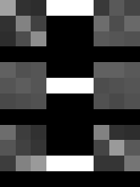
External states
Markov blanket
Structure learning
Complexity
Accuracy

Slide 28
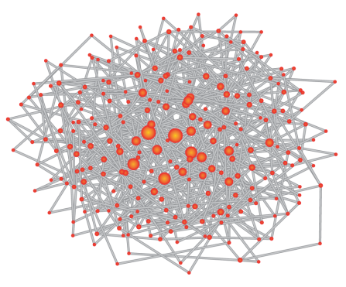
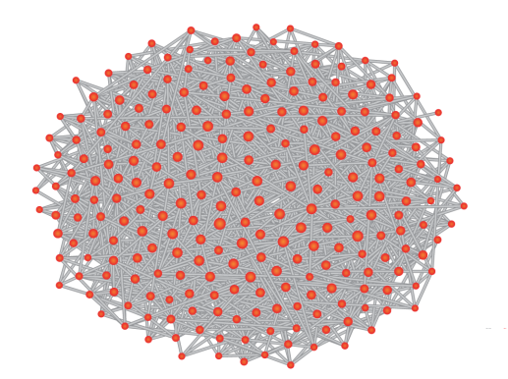
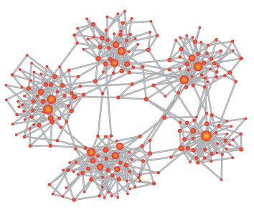

Bayesian model reduction and structure learning
Parametric learning
Structure learning
Experience dependent or associative plasticity
Complexity minimising synaptic regression

Slide 29
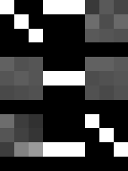
Insight and model reduction
Sample: left - center - right
Priors
Rule: right - center - left
Correct color
Correct color
Posteriors
Reduced
Correct color
Correct color

Slide 30
Sleep and the emergence of insight
Without model reduction
With model reduction (sleep)
64 subjects

Slide 31
Self-evidencing
Sources and uncertainty
Resolution of uncertainty
Epistemic affordance
Uncertainty about states of the world
Salience
Planning and inference
Uncertainty about contingencies
Parametric learning
Novelty
Uncertainty about the generative model
Structure learning
Knowledge

Slide 32
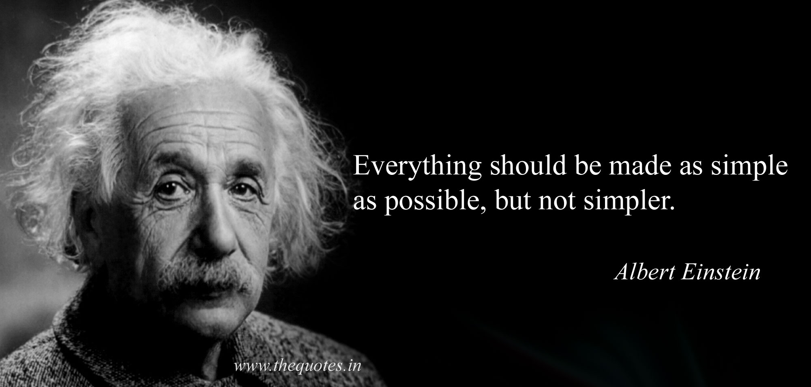
+
=
simplicity
accuracy
evidence

Slide 33
Thank you
And thanks to collaborators:
Rick Adams
Ryszard Auksztulewicz
Andre Bastos
Sven Bestmann
Harriet Brown
Jean Daunizeau
Mark Edwards
Chris Frith
Thomas FitzGerald
Xiaosi Gu
Stefan Kiebel
James Kilner
Christoph Mathys
Jérémie Mattout
Rosalyn Moran
Dimitri Ognibene
Sasha Ondobaka
Will Penny
Giovanni Pezzulo
Lisa Quattrocki Knight
Francesco Rigoli
Klaas Stephan
Philipp Schwartenbeck
And colleagues:
Micah Allen
Felix Blankenburg
Andy Clark
Peter Dayan
Ray Dolan
Allan Hobson
Paul Fletcher
Pascal Fries
Geoffrey Hinton
James Hopkins
Jakob Hohwy
Mateus Joffily
Henry Kennedy
Simon McGregor
Read Montague
Tobias Nolte
Anil Seth
Mark Solms
Paul Verschure
And many others

Slide 34
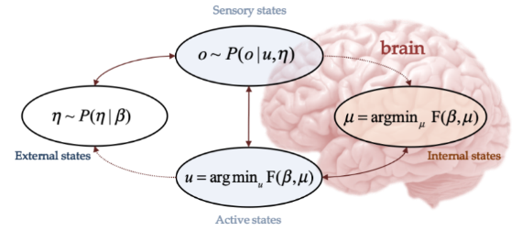
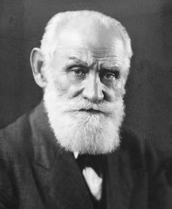
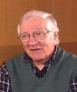
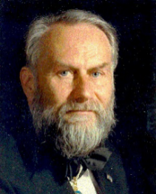
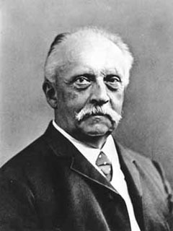
Self-evidencing
Perception
Action
Reinforcement learning
Optimal control theory
Expected utility theory
Infomax principle
Minimum redundancy
Free-energy principle
Self-organization
Synergetics
Homoeostasis
Bayesian brain
Evidence accumulation
Predictive coding
Value
Surprise
Entropy
Model evidence
Pavlov
Barlow
Haken
Helmholtz

Slide 35
Π
S
O
Π
S
O
Risk
Ambiguity
Information gain
Entropy
KL control
Empowerment
Bayesian design
Bayesian risk
Information Bottleneck
Active inference

